Slide 1
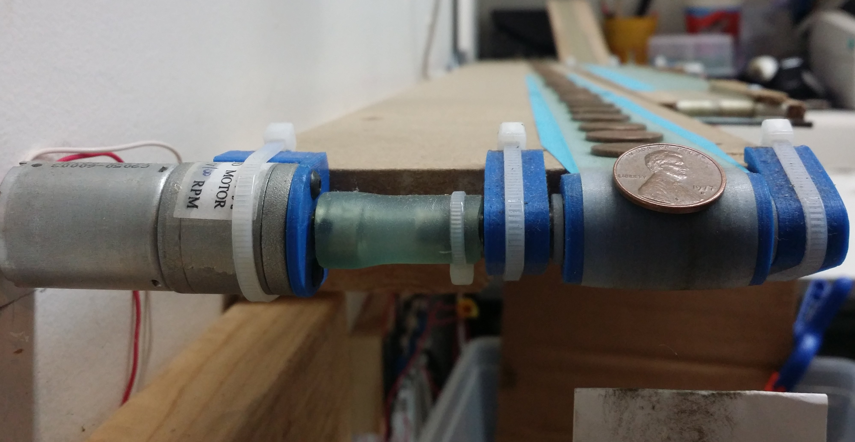
Deep Learning with Caffe & DIGITS for Robotic Coin Collecting
https://github.com/GemHunt/CoinSorter

Slide 2
Who am I?
Software developer and mechatronics engineer
Mechatronics?
GemHunt.com: Am I going the startup route? Again?
Live Carol Stream with my wife and two boys

Slide 3

Questions? Comments? Feel free to Stop me! Or just Post a GitHub issue github.com/GemHunt/CoinSorter

Slide 4
Start Time | Minutes
7:00 PM | 10 | UniForum Intro
7:10 PM | 5 | Presentation Intro
7:15 PM | 5 | Check out the GitHub: Project Goals/Milestones
7:20 PM | 5 | What is Deep Learning?
7:25 PM | 5 | What is Caffe/Digits?
7:30 PM | 10 | Installing Caffe & Digits (AWS/Windows)
7:40 PM | 15 | Using Digits
7:55 PM | 10 | CoinSorter pipeline & Issues
8:05 PM | 10 | Results / Demo of the second version
8:15 PM | 10 | Next Steps/ Issues/ Future
8:25 PM | 35 | Questions

Slide 5
First, Lets check out The Last Version
https://www.youtube.com/watch?v=_fJcIxWgQbs

Slide 6
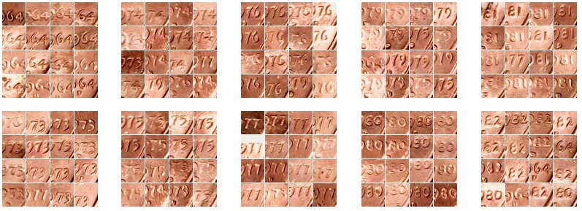
What Is this all about?: Finding Pennies Coins by Date

Slide 7
Why I am doing this?
A step to discover new types of rare coin varieties and mint-made errors
To learn about machine vision & machine learning
Because it’s newly scalable in many different ways
To make $$$? Maybe. More importantly to open doors I didn’t know existed.

Slide 8
Head over to https://github.com/GemHunt/CoinSorter

Slide 9
What is Deep Learning?
From Wikipedia: Deep learning is a branch of machine learning based on a set of algorithms that attempt to model high-level abstractions in data by using multiple processing layers with complex structures or otherwise, composed of multiple non-linear transformations.
Backup? What is machine learning?
Creating a tool to classify data without explicitly telling the computer how to.
Either by giving similar data (Supervised)
Or by some form of grouping (Unsupervised)
CoinSorter is mostly supervised…

Slide 10
Again, What is Deep Learning?
Most popular example: Supervised classification of images
(using pre-labels images to find more like them)
High level tool with no programing
Using Neural networks
Trained On GPUs
A buzz word for something that has existed for a long time, but for a number of reasons has started really taking off.
Caffe, Torch, Theano are the big three libraries
http://cs.stanford.edu/people/karpathy/convnetjs/

Slide 11
What is Caffe & Digits?
Caffe:
https://docs.google.com/presentation/d/1UeKXVgRvvxg9OUdh_UiC5G71UMscNPlvArsWER41PsU/edit#slide=id.gc2fcdcce7_216_
NVIDIA’s DIGETS is a web based front end to Caffe.
We will see a lot more in a bit…

Slide 12
Installation & Setup of Caffe & digits
Checkout: https://github.com/GemHunt/CoinSorter/blob/master/scripts/AWSCaffeDigetsBuild.md

Slide 13
Using Digits
Using sets of images to train models.
Jump some of the details to introduce DIGITS…
…then we will come back and put it all together.

Slide 14
OpenCV: Image captured from webcam, triggered by IR sensor from Arduino
OpenCV: Removal of skew (caused by coin moving at high speed)
OpenCV: Threshold in Cr component of the YCbCr space
OpenCV: Coin image crop from contour detection
Image Processing Pipeline:

Slide 15
OpenCV: Coin image crop from contour detection
Caffe CNN: Coin date classification, a stock cifar10 network, 32x32 color
Caffe CNN: Coin orientation classification (images rotated to create 360 different categories) LeNet with an additional set of conv & pooling layers, 2x output, 64x64 gray
Caffe CNN: Coin design classification (Heads vs Tails vs Other…) LeNet with an additional set of conv & pooling layers. 2x output, 60x60 gray, 12x rotational augmentation
Caffe CNN: Detection of the 5% poorly cropped coins with a
stock cifar10 network, 32x32 color

Slide 16
Image Processing Pipeline In C++
Check out model folders and C++ code:
https://github.com/GemHunt/CoinSorter/blob/master/windowsCppSource/classification.cpp#L249

Slide 17
Demo of live system
Test lights more durable than thought
Cause skew by hand
Obscure date
Try different rotations on rare dates

Slide 18
Next Steps
https://github.com/GemHunt/CoinSorter/milestones/Future%20Milestones

Slide 19
Questions & Comments
Post an issue at:
https://github.com/GemHunt/CoinSorter
Or email me at:
pkrush@gemhunt.com

